Slide 1
Classroom slides – processor scheduling

Slide 2
Low memory
Use by the OS
Program code
Memory footprint
of
User program
Program global data
Program heap
Program stack
Use by the OS
High memory

Slide 3
Problem spec
Human
Partial binary
Libraries
Algorithm
Linker
Editor
C Code
Executable binary
Compiler
Loader
Memory
Footprint

Slide 4
Program 1
Program 2
.
.
.
Program n
OS Data
Structures
OS routines

Slide 5
Program 1
system
properties
Program 2
scheduler
Processor
.
.
.
winner
Program n

Slide 6
Name | Usual Connotation | Use in this chapter
Job | Unit of scheduling | Synonymous with process
Process | Program in execution; unit of scheduling | Synonymous with job
Thread | Unit of scheduling and/or execution; contained within a process | Not used in the scheduling algorithms described in this chapter
Task | Unit of work; unit of scheduling | Not used in the scheduling algorithms described in this chapter, except in describing the scheduling algorithm of Linux

Slide 7
Disk
memory
p₁
Long-term
scheduler
u₁
u₂
…..
u_{n}
p₂
.
.
.
p₁
p₂
…..
p_{q}
Medium-
term
scheduler
Swap space
p_{m}
Short-term
scheduler
Dispatcher
CPU

Slide 8
Name | Environment | Role
Long term scheduler | Batch oriented OS | Control the job mix in memory to balance use of system resources (CPU, memory, I/O)
Loader | In every OS | Load user program from disk into memory
Medium term scheduler | Every modern OS (time-shared, interactive) | Balance the mix of processes in memory to avoid thrashing
Short term scheduler | Every modern OS (time-shared, interactive) | Schedule the memory resident processes on the CPU
Dispatcher | In every OS | Populate the CPU registers with the state of the process selected for running by the short-term scheduler

Slide 9
Process and render
the track to speaker;
initiate reading next
track from CD
Initiate reading
music track
from CD
Read a music
track from CD
Render music to
speaker; read music
track from CD
CPU burst
I/O burst
CPU burst
I/O burst
….
CPU burst
I/O burst
Time line

Slide 10
PCB
enum state_type {new, ready, running, waiting, halted};
typedef struct control_block_type {
enum state_type state;
address PC;
int reg_file[NUMREGS];
struct control_block *next_pcb;
int priority;
address memory_footprint;
….
….
} control_block;

Slide 11
Ready queue
PCB₁
PCB₂
…
PCB_{n}
I/O queue
PCB₁
PCB₂
…
PCB_{n}

Slide 12
Name | Description
CPU burst | Continuous CPU activity by a process before requiring an I/O operation
I/O burst | Activity initiated by the CPU on an I/O device
PCB | Process context block that holds the state of a process (i.e., program in execution)
Ready queue | Queue of PCBs that represent the set of memory resident processes that are ready to run on the CPU
I/O queue | Queue of PCBs that represent the set of memory resident processes that are waiting for some I/O operation either to be initiated or completed
Non-Preemptive algorithm | Algorithm that allows the currently scheduled process on the CPU to voluntarily relinquish the processor (either by terminating or making an I/O system call)
Preemptive algorithm | Algorithm that forcibly takes the processor away from the currently scheduled process in response to an external event (e.g. I/O completion interrupt, timer interrupt)
Thrashing | A phenomenon wherein the dynamic memory usage of the processes currently in the ready queue exceed the total memory capacity of the system

Slide 13
Metrics
P1
P2
P3
w1
e1
e2
e3
t1
w2
t2
w3
t3
w_{i}, e_{i}, and t_{i}, are respectively the wait time, execution time, and the
elapsed time for a job j_{i}
Throughput?
Avg. Turnaround Time?
Avg. Wait Time?
Response time?

Slide 14
Name | Notation | Units | Description
CPU Utilization | - | % | Percentage of time the CPU is busy
Throughput | n/T | Jobs/s | System-centric metric quantifying the number of jobs n executed in time interval T
Avg. Turnaround time (t_{avg}) | (t₁+t₂+…+t_{n})/n | Secs | System-centric metric quantifying the average time it takes for a job to complete
Avg. Waiting time (w_{avg}) | (w₁+w₂+ …+w_{n})/n | Secs | System-centric metric quantifying the average waiting time that a job experiences
Response time | t_{i} | Secs | User-centric metric quantifying the turnaround time for a specific job I
Variance in Response time | E[(t_{i} –t_{avg})²] | Secs² | User-centric metric that quantifies the statistical variance of the actual response time (t_{i}) experienced by a process (P_{i}) from the expected value (t_{avg})
Starvation | - | - | User-centric qualitative metric that signifies denial of service to a particular process or a set of processes due to some intrinsic property of the scheduler
Convoy effect | - | - | User-centric qualitative metric that results in a detrimental effect to some set of processes due to some intrinsic property of the scheduler

Slide 15
FCFS
CPU
10
1
2
I/O
10
2
3
P1
P2
P3
CPU
P1
P2
P3
P1
P2
P3
10
1
2
7
10
1
2
7
I/O
P1
P2
P3
P1
10
10
2
3
5
10

Slide 16
SJF
CPU
10
1
2
I/O
10
2
3
P1
P2
P3
CPU
P2
P3
P2
P1
P3
P1
1
2
1
10
2
8
10
I/O
P2
P3
P1
1
2
3
8
10

Slide 17
Priority Scheduler
ready_q
PCB₁
PCB₂
…
PCB_{n}
Level L
PCB₁
PCB₂
…
PCB_{n}
Level L-1
…….
…….
…….
PCB₁
PCB₂
…
PCB_{n}
Level 1

Slide 18
Preemptive Schedulers
FCFS with preemption
SJF with preemption
  SRTF (Shortest Remaining Time First)
Priority with preemption
Round robin

Slide 19
PCB
enum state_type {new, ready, running, waiting, halted};
typedef struct control_block_type {
enum state_type state;
address PC;
int reg_file[NUMREGS];
struct control_block *next_pcb;
int priority;
address memory_footprint;
….
….
} control_block;

Slide 20
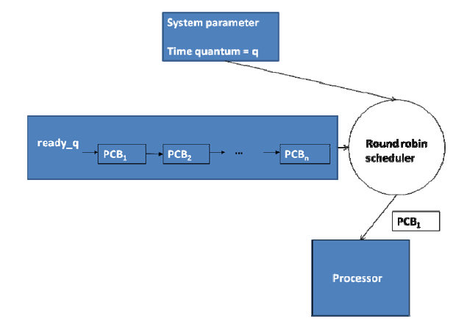
Round Robin

Slide 21
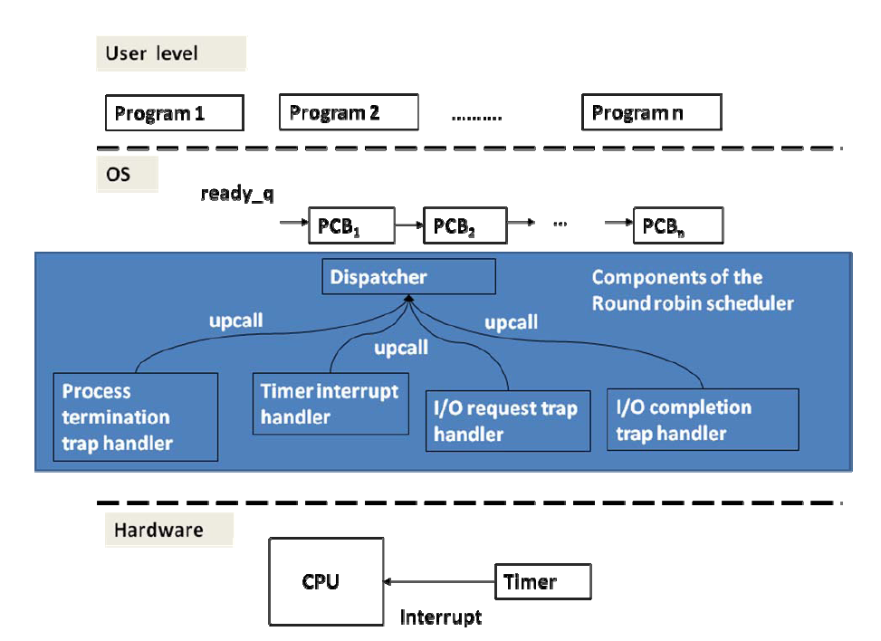

Slide 22
Scheduler:
get head of ready queue;
set timer;
dispatch;
Timer interrupt handler:
save context in PCB;
upcall to scheduler;
I/O request trap:
save context in PCB;
move PCB to I/O queue;
upcall to scheduler;
I/O completion interrupt handler:
save context in PCB;
move PCB of I/O completed process to ready queue;
upcall to scheduler;
Process termination trap handler:
Free PCB;
upcall to scheduler;

Slide 23
Multi-Level Scheduler
Meta scheduler
ready_q
PCB₁
PCB₂
…
PCB_{n}
Q
Q
Interactive jobs
batch jobs
ready_q
PCB₁
PCB₂
…
PCB_{n}

Slide 24
Domains | Environment | Workload characteristics | Types of schedulers
Desktop | Timeshared, interactive, multiprogrammed | I/O bound | Medium-term, short-term, dispatcher
Servers | Timeshared, multiprogrammed | Computation bound | Medium-term, short-term, dispatcher
Business | Timeshared, multiprogrammed | I/O bound | Medium-term, short-term, dispatcher
HPC | Timeshared, multiprogrammed | Computation bound | Medium-term, short-term, dispatcher
Grid | Batch-oriented, timeshared, multiprogrammed | Computation bound | Long-term, Medium-term, short-term, dispatcher
Embedded | Timeshared, interactive, multiprogrammed | I/O bounds | Medium-term, short-term, dispatcher
Pervasive | Timeshared, interactive, multiprogrammed | Combination of I/O bound and computation bound | Medium-term, short-term, dispatcher

Slide 25
Name | Property | Scheduling criterion | Pros | Cons
FCFS | Intrinsically non-preemptive; could accommodate preemption at time of I/O completion events | Arrival time (intrinsic property) | Fair; no starvation; | high variance in response time; convoy effect
SJF | Intrinsically non-preemptive; could accommodate preemption at time of new job arrival and/or I/O completion events | Expected execution time of jobs (intrinsic property) | Preference for short jobs; provably optimal for response time; low variance in response times | Potential for starvation; bias against long running computations
Priority | Could be either non-preemptive or preemptive | Priority assigned to jobs (extrinsic property) | Highly flexible since priority is not an intrinsic property, its assignment to jobs could be chosen commensurate with the needs of the scheduling environment | Potential for starvation
SRTF | Similar to SJF but uses preemption | Expected remaining execution time of jobs | Similar to SJF | Similar to SJF
Round robin | Preemptive allowing equal share of the processor for all jobs | Time quantum | Equal opportunity for all jobs; | Overhead for context switching among jobs

Slide 26
Linux – a case study
Markets
  Desktop (interactive) and server
Goals
  Efficiency, interactivity, real-time, no starvation
Three classes of tasks
  Real-time FCFS, real-time RR, timeshared
  140 priority levels
    0-99 for real-time; remaining for timeshared
    Carrot and stick approach
    Starvation threshold

Slide 27
runqueue
Other stuff
Active
P
P
0
P
.
.
Priority
Arrays
P
P
P
139
Expired
0
P
P
P
139

Slide 28
Example :
Consider a non-preemptive First Come First Served (FCFS) process scheduler.
There are three processes in the scheduling queue and the arrival order is
P1, P2, and P3. The arrival order is always respected when picking the next process
to run on the processor. Scheduling starts at time t = 0, with the following
CPU and I/O burst times:
CPU burst time I/O burst time
P1 8 2
P2 5 5
P3 1 5
Each process terminates after completing the following sequence of three actions:
CPU burst
I/O burst
CPU burst
Show the CPU and I/O timelines that result with FCFS scheduling from t = 0 until
all three processes complete.
b) What is the response time for each process?
c) What is the waiting time for each process?

Slide 29
Solution sketch
Time
CPU
P1
P2
P1
P2
P3
P3
8 5 8 5 1 5 1
I/O
P1
P2
P3
8 2 3 5 3 5 1 5

Slide 30
Example:
Consider a FCFS process scheduler. There are three
processes in the scheduling queue and assume that all
three of them are ready to run. As the scheduling discipline
suggests, the scheduler always respects the arrival time in
selecting a winner. Assume that P1, P2, and P3 arrive
in that order into the system. Scheduling starts at time t = 0.
The CPU and I/O burst patterns of the three processes
are as shown below:
CPU I/O CPU I/O CPU
P1 5 5 5 3 5 P1 done
P2 2 5 5 P2 done
P3 3 2 2 P3 done
Show the CPU and I/O timelines that result with FCFS
scheduling from t = 0 until all three processes complete.

Slide 31
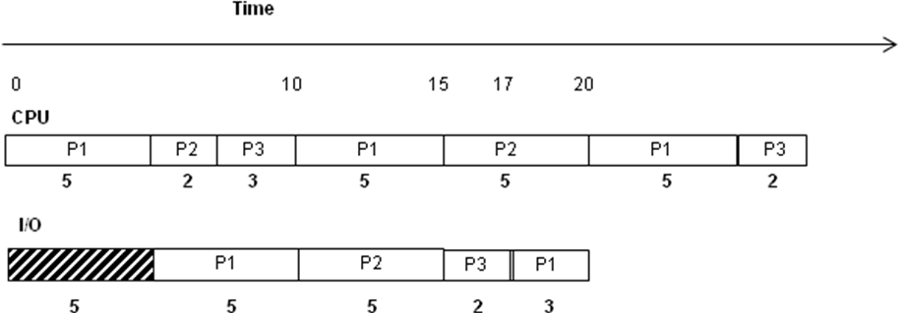
Solution sketch

Slide 32
Example:
Consider a non-preemptive Shortest Job First (SJF) process
scheduler. There are three processes in the scheduling queue
and assume that all three of them are ready to run.
As the scheduling discipline suggests, always the shortest job
that is ready to run is given priority. Scheduling starts at
time t = 0. The CPU and I/O burst patterns of the three
processes are as shown below:
CPU I/O CPU I/O CPU
P1 4 2 4 2 4 P1 is done
P2 5 2 5 P2 is done
P3 2 2 2 2 2 P3 is done
Each process exits the system once its CPU and I/O bursts
as shown above are complete.
Show the CPU and I/O timelines that result with SJF
scheduling from t = 0 until all three processes exit the system.
b) What is the waiting time for each process?
c) What is the average throughput of the system?

Slide 33
Solution sketch
CPU Schedule (SJF)
2 4 2 4 2 4 5 2 5
P3 P1
P3 P1
P3 P1
P2
P2
0 25 29
Timeline
I/O Schedule
2 24
P3
P1
P3
P1
P2
2 2 2 2 2 2 4 5 2

Slide 34
Example:
Consider the following four processes vying for the CPU.
The scheduler uses SRTF.
The table shows the arrival time of each process.
Process | Arrival Time | Execution Time
P1 | T₀ | 4ms
P2 | T₀+1ms | 2ms
P3 | T₀+2ms | 2ms
P4 | T₀+3ms | 3ms
Show the schedule starting from T0 for SRTF.
What is the waiting time for each process?
What is the average wait time?
What is the schedule for with FCFS?
What is the average wait time with FCFS?

Slide 35
Example :
What is the wait time for each of the three processes
with round robin schedule?
CPU I/O CPU I/O
P1 4 2 2 P1 is done
P2 3 2 2 P2 is done
P3 2 2 4 2 P3 is done

Slide 36
Solution sketch
CPU Schedule (Round Robin, timeslice = 2)
2 2 2 2 1 2 2 2 2
P1
P2
P3
P1
P2
P3
P1
P3
P2
0 1 2 3 4 5 6 7 8 9 10 11 12 13 14 15 16
I/O Schedule
6 8 10 11 12 14 15 16
P3
P1
P2
P3
2 2 2 3 2

